Slide 1
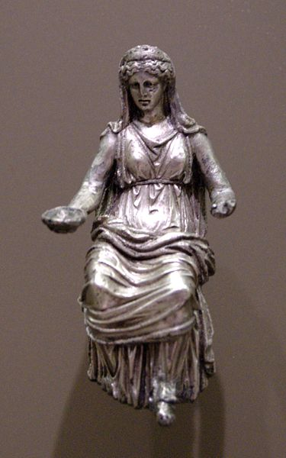
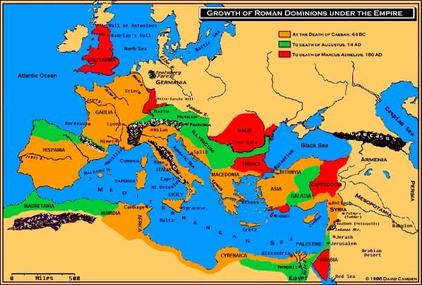
Religion in the Roman Empire

Slide 2
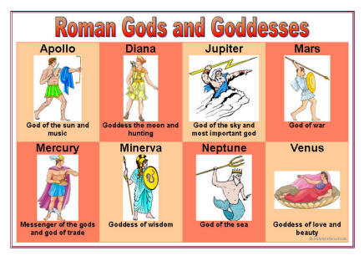
Religion in the Empire
Early Roman religion:
Polytheistic
Heavily influenced by ancient Greeks
Linked closely to government

Slide 3
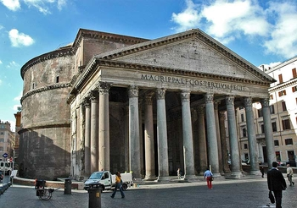
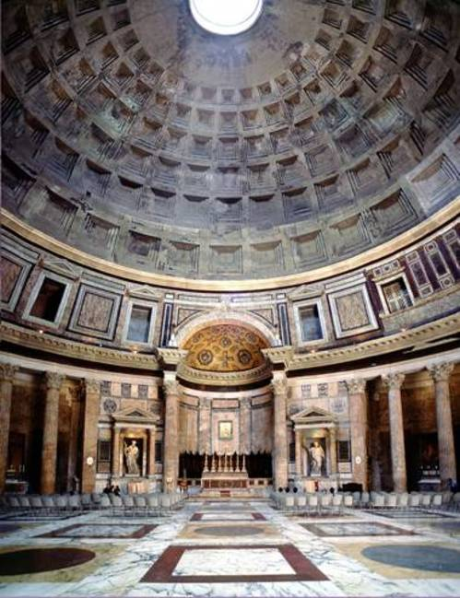
Pantheon:
Temple to all Roman gods and goddesses

Slide 4
Religion in the Empire
Primary Roman Gods & Goddesses:
Jupiter – king of the gods
Juno – queen of the gods; goddess of marriage
Minerva – goddess of wisdom

Slide 5
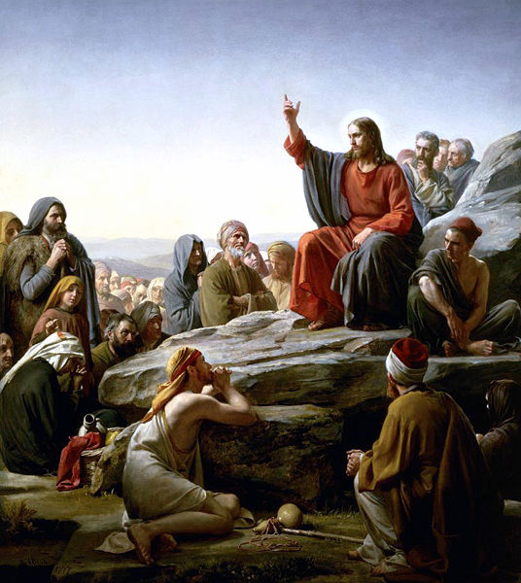
The Emergence of Christianity

Slide 6
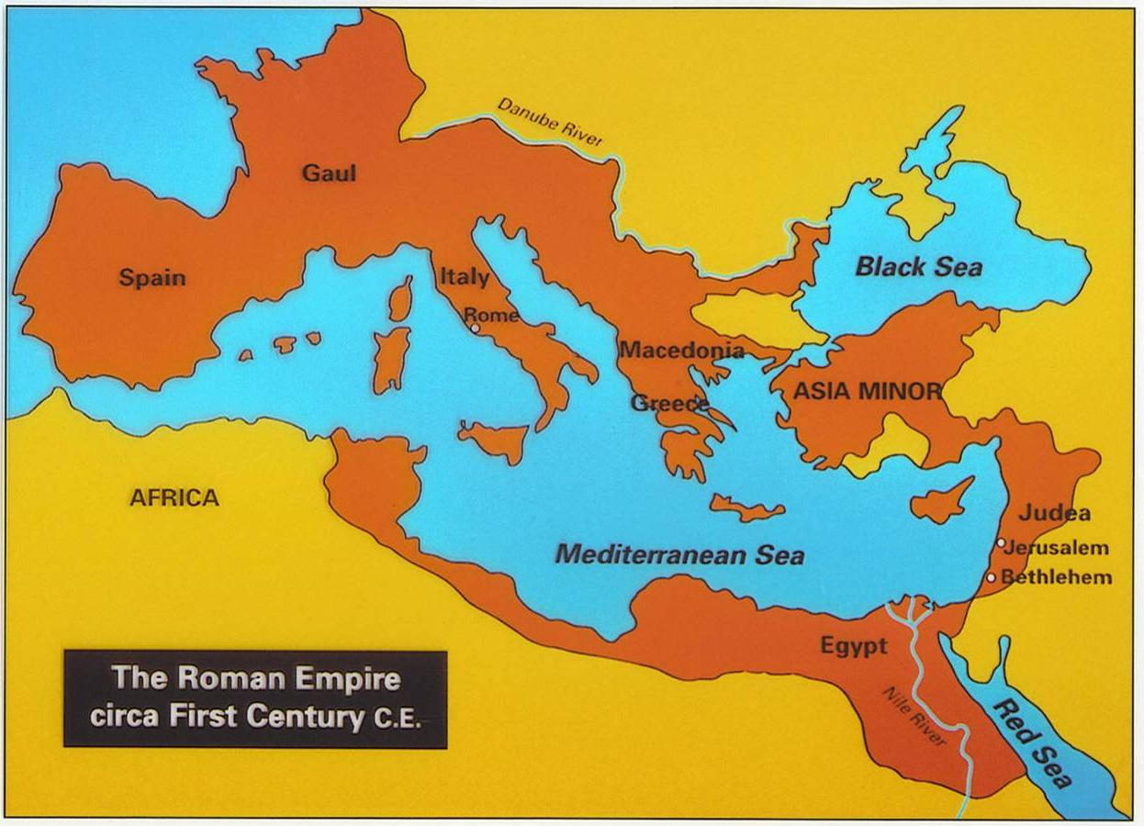
The Beginnings
By 63 BC Roman power had spread to Judea, home of the Jewish people
At this point Judea became part of the Roman empire
Notes:
Roman soldiers carrying the Menorah

Slide 7
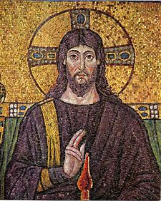
The Beginnings
According to Biblical tradition, God had promised that a savior known as the Messiah would arrive & restore the kingdom of the Jews

Slide 8
The Beginnings
A Jew named Jesus was born sometime between 6 & 4 BC; raised in the village of Nazareth
At about the age of 30, Jesus began to preach. His message included many ideas from Jewish traditions, such as principles of the 10 Commandments and belief in one God. According to Jesus’ apostles (close followers), he performed many miracles. His fame grew, and some believed him to believe the long-awaited Messiah.

Slide 9
The Beginnings
Taught disciples that people must love God, their neighbors, their enemies & themselves
“Blessed are the meek, for they shall inherit the Earth…”
Who would this appeal to? Why?
Who would this threaten? Why?

Slide 10
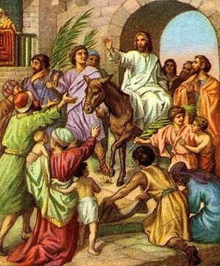
The Beginnings
In AD 29 Jesus visited Jerusalem
Enthusiastic crowds greeted him as the Messiah BUT…
Jewish leaders denied that Jesus was the Messiah
Roman governor, Pontius Pilot, accused Jesus of defying Roman authority & sentenced him to death

Slide 11
The Spread of Christianity

Slide 12
Spread of Christianity
According to the Gospels, Jesus rose from the dead and ascended into heaven
Followers became known as Christos (Greek word for messiah)

Slide 13
Spread of Christianity
Jesus’ followers came to be called Christians. Led by Peter, the first apostle, they spread his teachings throughout Palestine and Syria. At first Jesus’ followers were all Jewish. Later, under one apostle, Paul, Christians began to look to all people, even non-Jews, to join the church.

Slide 14
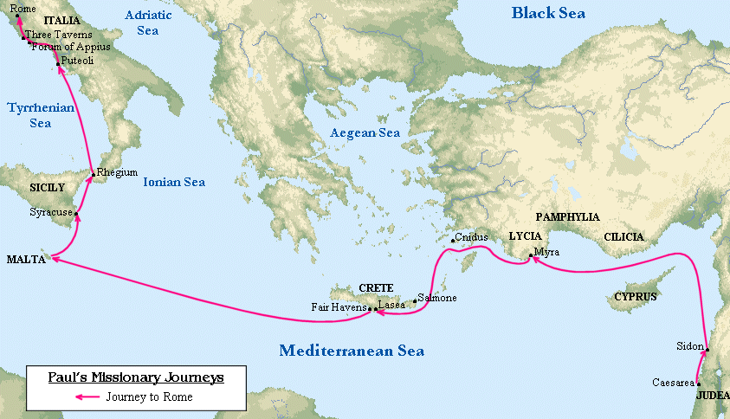
Spread of Christianity
The apostle, Paul, helped spread Christianity
Wrote letters about Jesus; helped convert non-Jews

Slide 15
Spread of Christianity
How did the organization of the Roman Empire help the spread of Christianity?
Excellent Roads (easy to move around)
Common Languages (Greek & Latin)

Slide 16
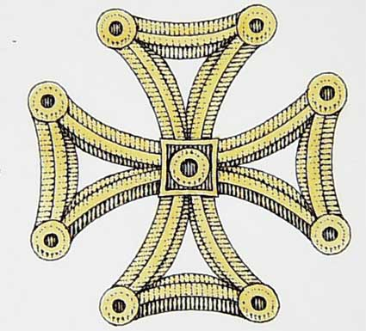
Spread of Christianity
Christianity first appealed to the poor
Offered salvation & provided hope for a better life
Emphasized equality
Embraced ALL people

Slide 17
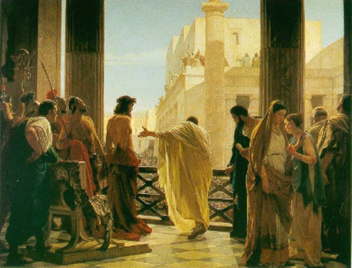
Early Christians in the Roman Empire

Slide 18
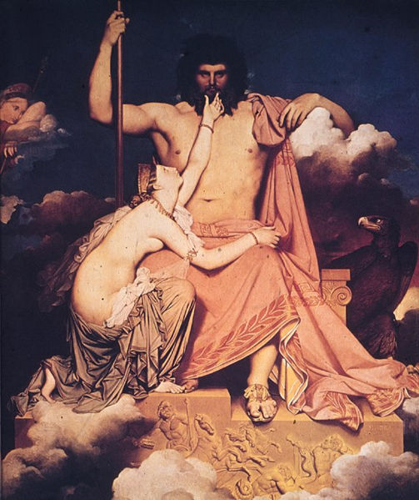
Early Christians
Roman Leaders DID NOT like Christianity
Threatened their rule
Did not worship Roman gods
Used Christians as scapegoats for political and economic problems

Slide 19
Early Christians
In the summer of AD 64, there was a large fire in Rome that burned uncontrollably for weeks. The Emperor, Nero, blamed the Christians for the fire and many were sent to the games to be torn apart by wild animals for the entertainment of the people of Rome – 600 were even arranged around the top of the Colosseum in Rome, set on fire to serve as “stadium lights.”

Slide 20
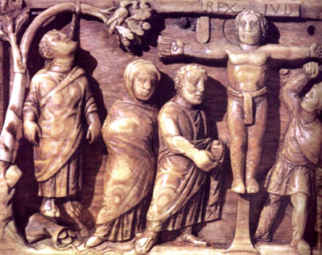
Early Christians
What happened to early Christians?
PERSECUTED & PUT ON TRIAL
If one was found guilty of following Christian beliefs he/she had 2 choices…

Slide 21
Early Christians
Choice #1:
Deny beliefs & live
Choice #2:
Refuse to deny beliefs & be put to death

Slide 22
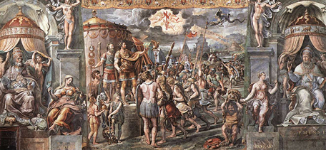
Early Christians
Persecution of Christians ended in AD 313 when Emperor Constantine granted the freedom of worship & religion to Christians

Slide 23
Early Christians
In AD, 313, Christianity entered a new era. The Roman emperor Constantine said that Christians would no longer be persecuted. Constantine, a general in 312 AD, reported that just before a crucial battle he had a dream where he saw they symbol of the Cross in the sun, and was told to paint this symbol on his soldiers’ shields to ensure victory. He did this and won the battle, and decided in thanks that he would allow the whole empire to worship any religion freely. Constantine himself later converted to Christianity.

Slide 24
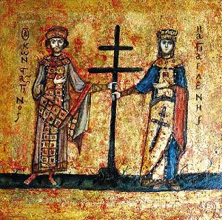
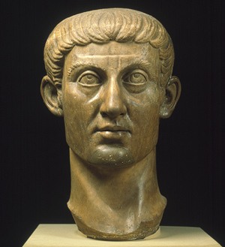
Early Christians
In 380, the Emperor Theodosius made it the official religion of the Roman Empire
What do you think happened to the Pantheon?

Slide 25
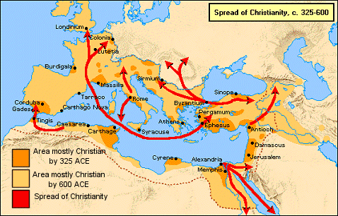

Slide 26
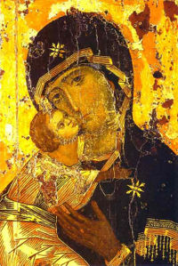
In a Nutshell…

Slide 27
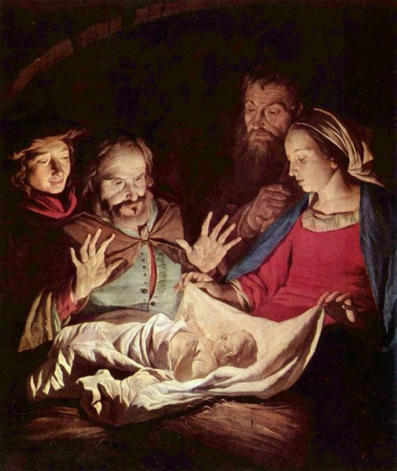
The Basics
Founder: Jesus Christ, son of God
Sacred Text: Bible
Symbols: Cross, Fish, Dove
Leaders: Priests, ministers, monks, nuns, etc.

Slide 28
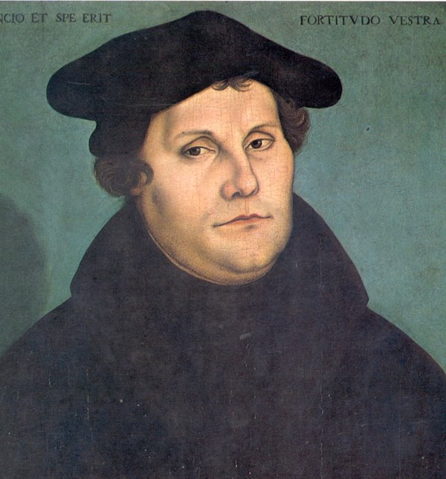
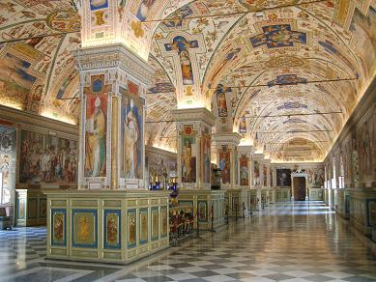
The Basics
Three Major Groups:
Roman Catholicism
Protestantism
Eastern Orthodox

Slide 29
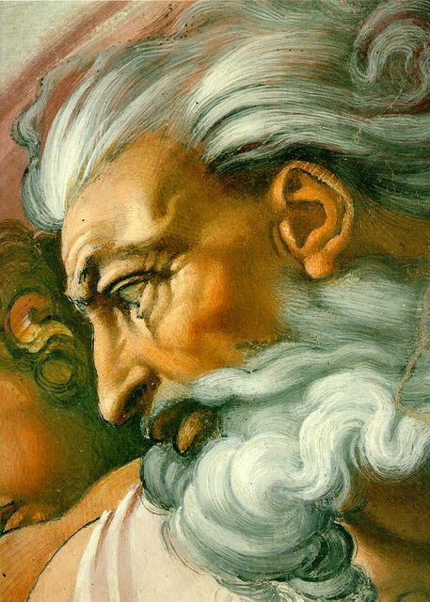
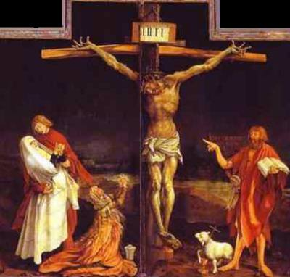
The Basics
ONE God; personal relationship to each human being
Jesus Christ died to save humanity from sin
Eternal life after death

