Slide 1
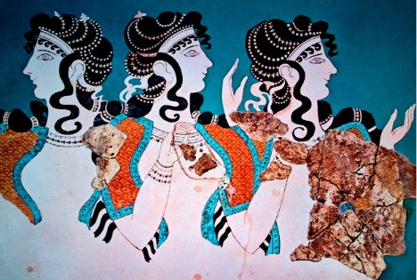
Early Aegean Civilization

Slide 2
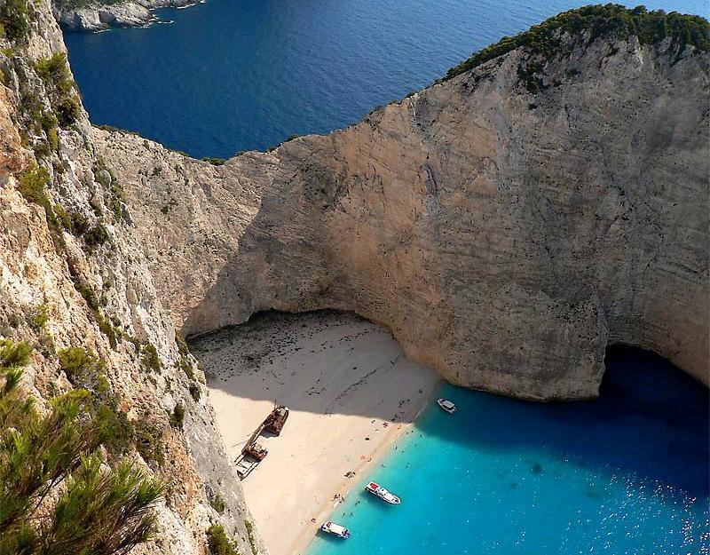

Slide 3
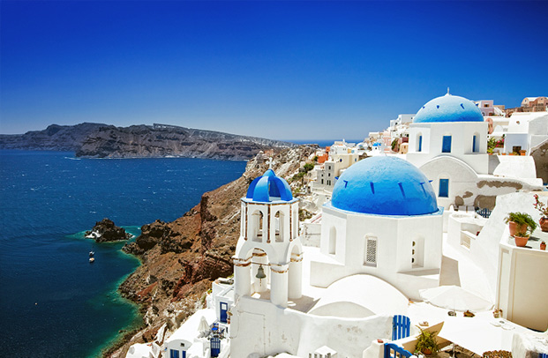

Slide 4
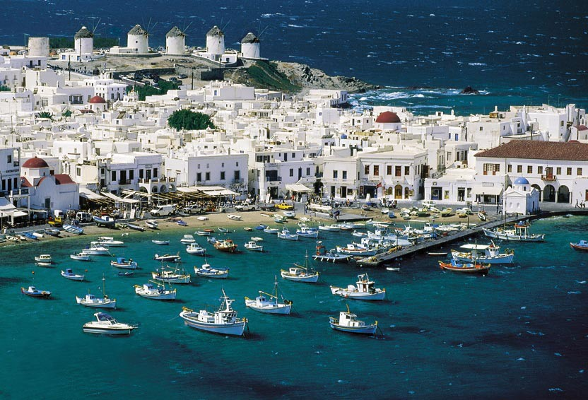

Slide 5
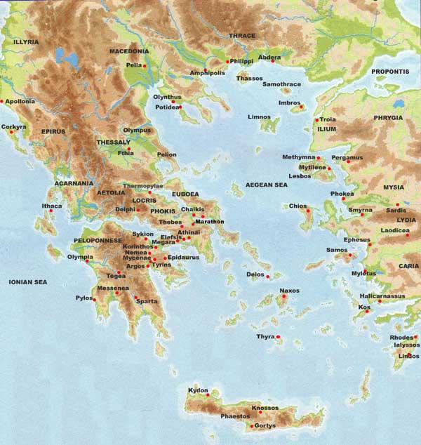
How did Geography help shape the ancient Greek civilization?

Slide 6
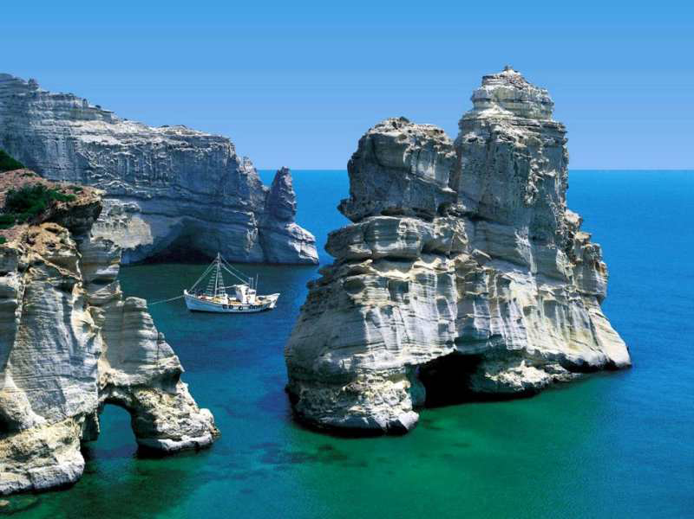
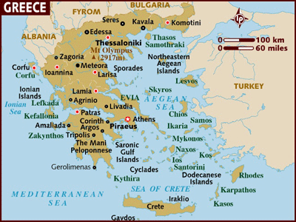
Influence of Geography
Greece is surrounded by:
Ionian Sea
Aegean Sea
Mediterranean Sea

Slide 7
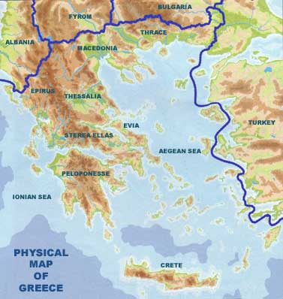
Influence of Geography
Mountains cover 75% of Greece
Divided land into many regions
Prediction: How did geography impact political structures?

Slide 8
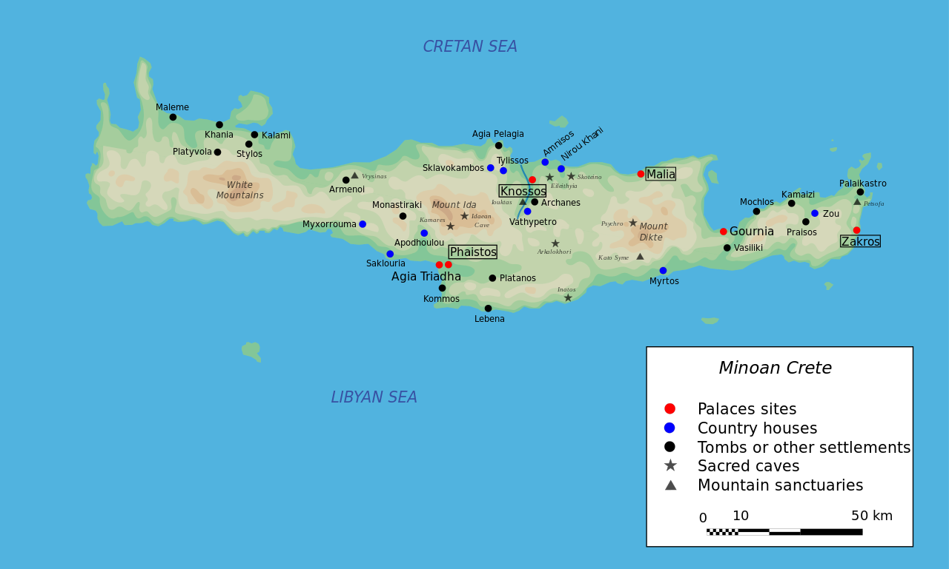
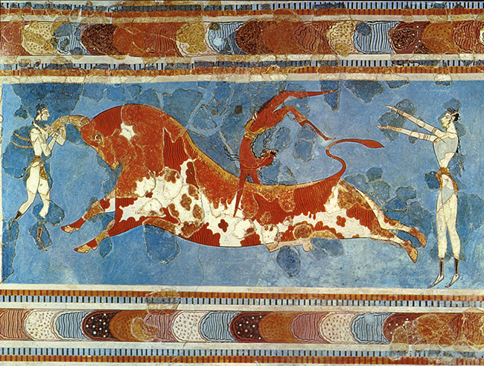
Minoan Civilization

Slide 9
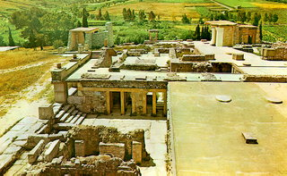
Minoan Civilization
Minoan Civilization was one of the earliest examples of what has come to be called Greek civilization
Minoans were trading at the same time as the Phoenicians, Egyptians and Babylonians
The Minoan Civilization may have been the foundation for the story of Atlantis.

Slide 10
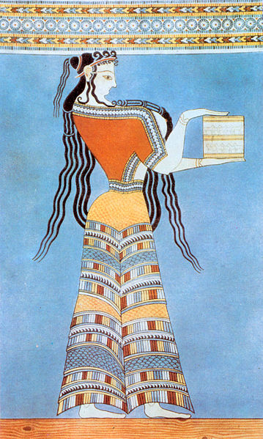
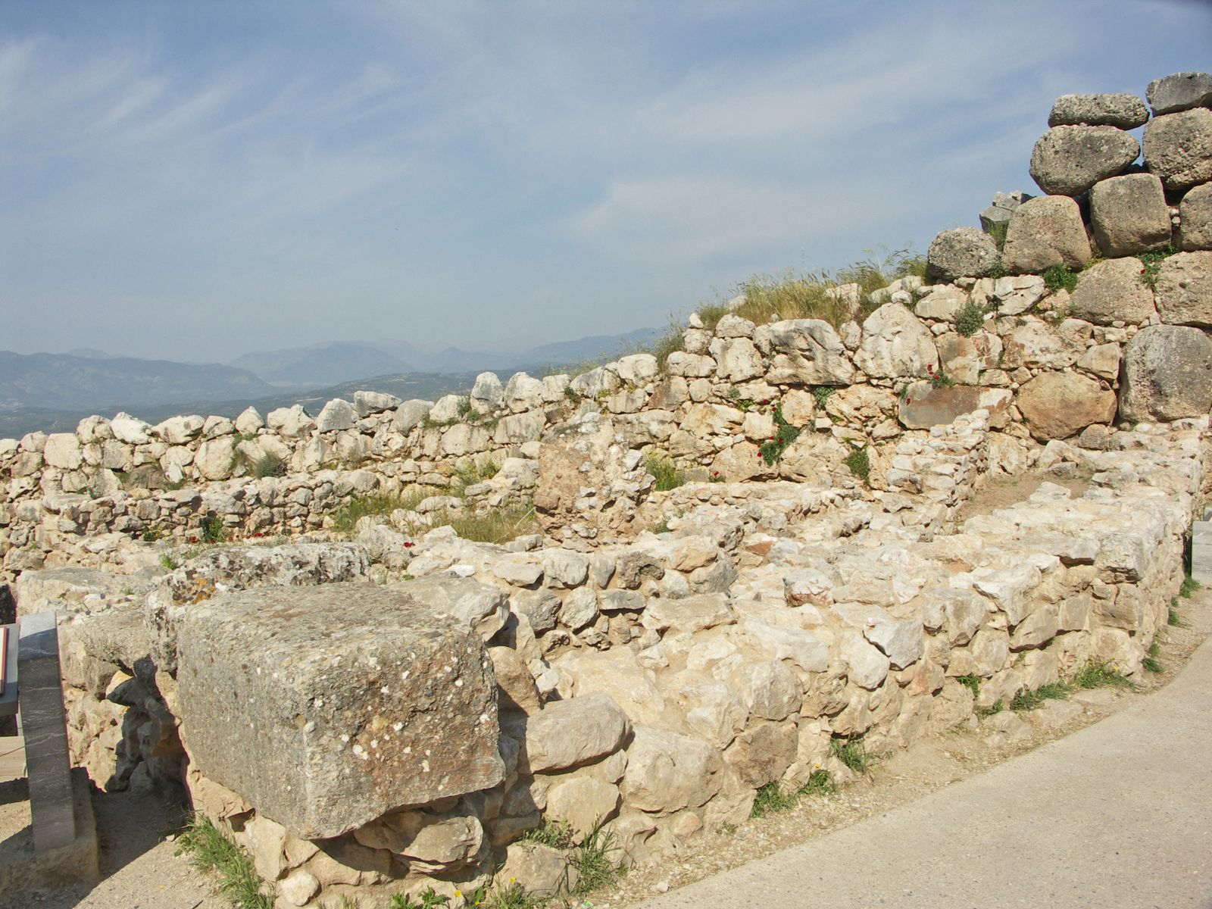
Mycenaean Civilization

Slide 11
Mycenaean Civilization
Mycenae was settled in 2000 BC
A warrior-king ruled Mycenae, as well as the surrounding villages
MILITARISTIC
Dominated from 1600 to 1100 BC

Slide 12
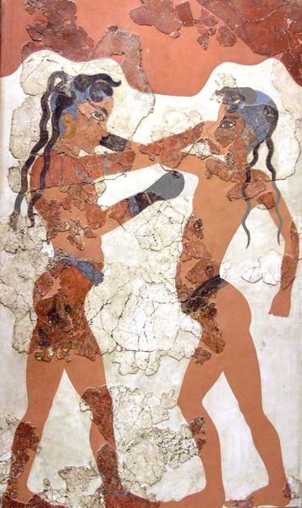
Mycenaean Civilization
In 1500 BC the Mycenaeans came in contact with Minoan civilization
The Minoans had a very LARGE impact on Mycenaean civilization

Slide 13
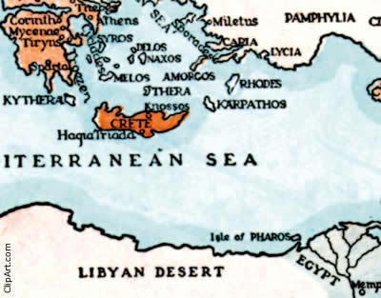
Mycenaean Civilization
From the Minoans the Mycenaeans adopted:
Seaborne trade, Minoan system of writing, Minoan art, etc.

Slide 14
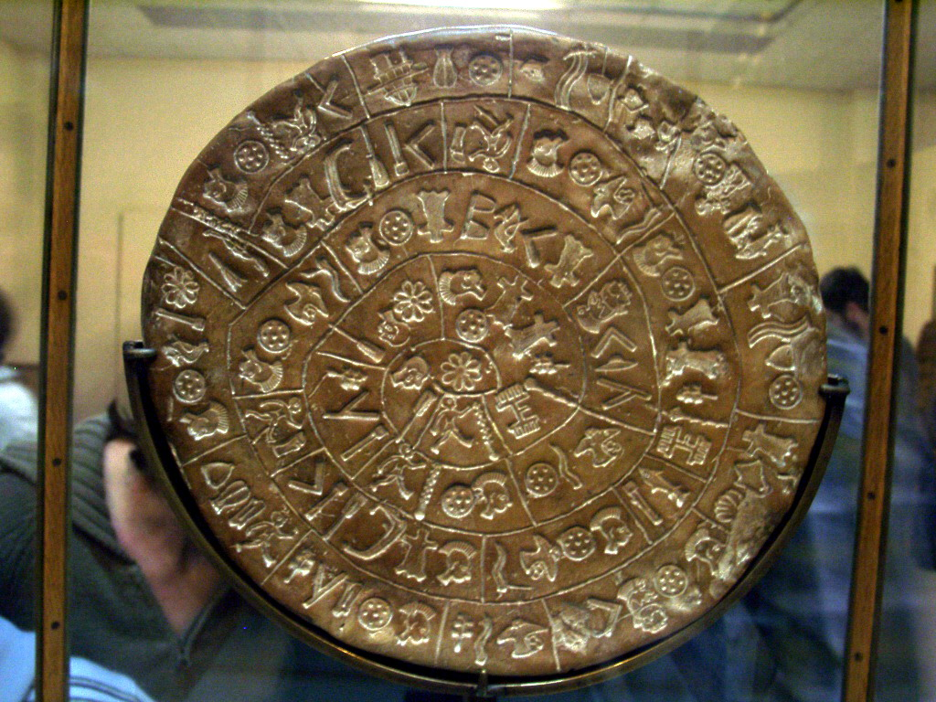
Linear A

Slide 15
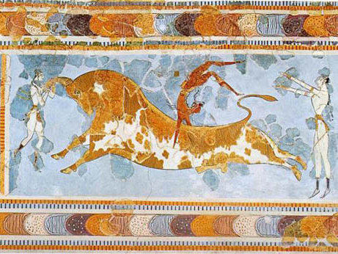
Minoan Bull Leaping…

Slide 16
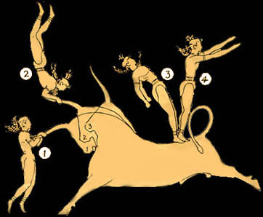

Slide 17
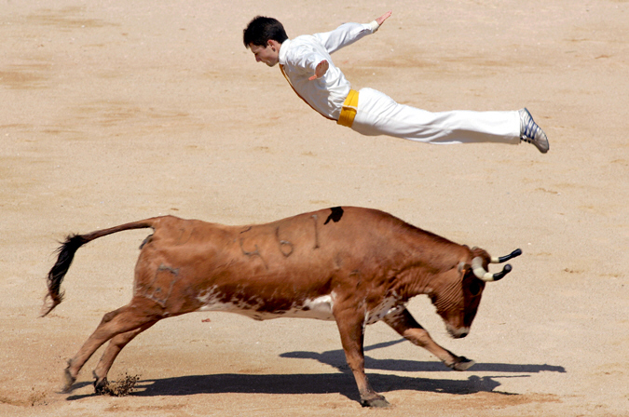
Modern day Spanish Recortador continues the bull leaping tradition that goes back to the legendary King Minos from Crete ‘s Minoan civilization. A Recortador jumping over a wild cow during a show in Pamplona, Spain on July 8, 2006

Slide 18
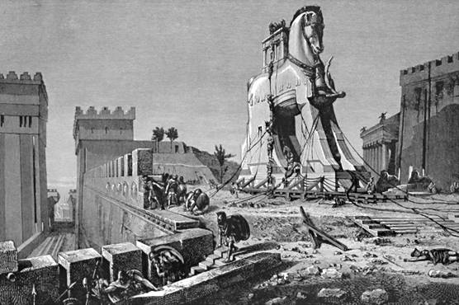
Dorian Invasions
About 1200BC, Mycenaeans fought a 10 year war against Troy (Anatolia) – Legend of the Trojan Horse
After the Trojan War Mycenaean civilization eventually collapsed
In 1200 BC the Dorian people moved into Mycenae

Slide 19
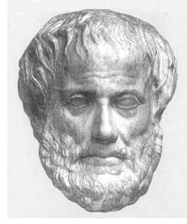
Dorian Invasions
Doh!
The Dorians were MUCH LESS advanced than the Mycenaeans
Resulted in the temporary decline of Greek culture

Slide 20
Why does it matter?
The contact between the Mycenaeans & the Minoans formed the core of Greek culture (i.e. religious practices, art, politics, literature…)
The foundation of Western Civilization…

Slide 21
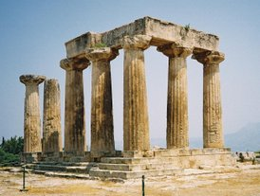
The City-State

Slide 22
Rise of the City-State
Polis:
Fundamental political unit of ancient Greece
Made up of a city & its surrounding land; generally home to less than 10,000

Slide 23
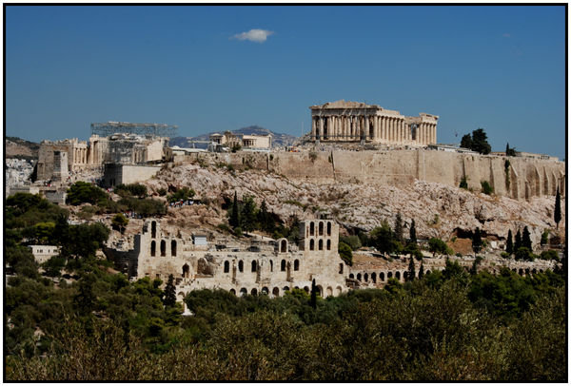
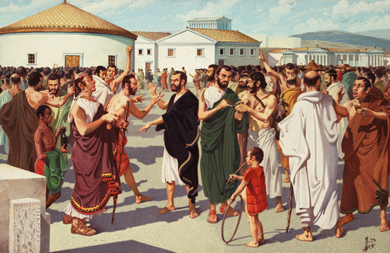
Rise of the City-State
Acropolis:
A fortified hilltop where Greek citizens gathered to discuss societal & political issues

Slide 24
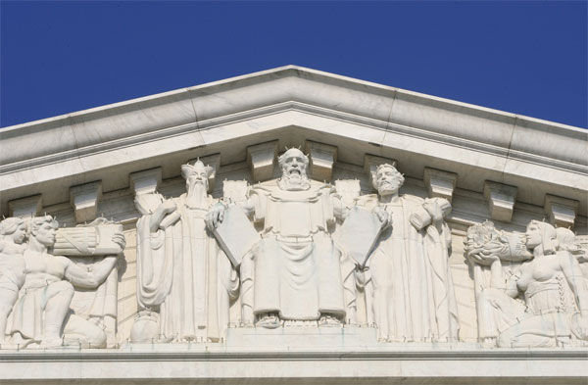
Political Structures
NO common political structure in ancient Greece
Individual city–states experimented with different forms of government

Slide 25
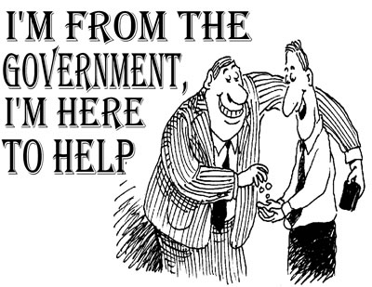
Thinking Questions…
What is the meaning of the word “Government”? particular community or place.
2. What types of government exist in the modern world?
3. What type of government does the United States have, and where did it originate?

Slide 26
Types of Gov’t in Ancient Greece

Slide 27
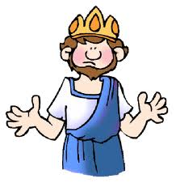
Monarchy
Power is in the hands of one person; KING
Citizens pay taxes, obey laws, & depend on kings for protection; kings inherit their power
Practiced in Mycenae (2000 BC)
Modern Day?: Saudi Arabia

Slide 28
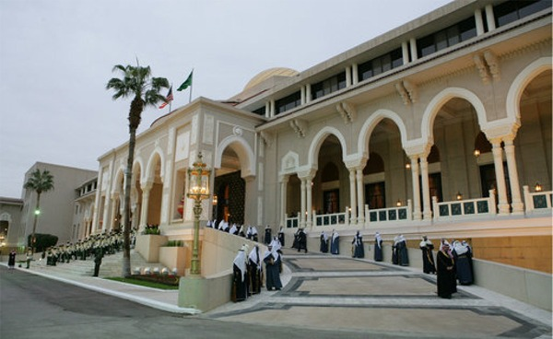

Slide 29
Aristocracy
Power is in the hands of the NOBILITY
Hereditary rule based on social rank & wealth
Practiced in Athens prior to 594 BC
Modern Day: Great Britain (House of Lords only)

Slide 30
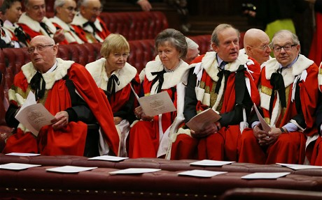
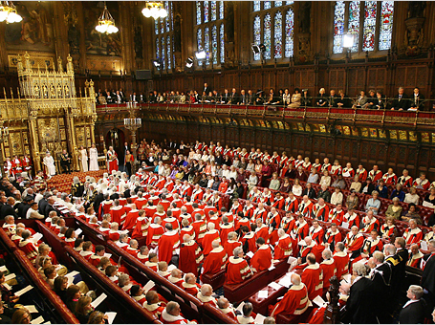

Slide 31
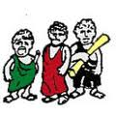
Oligarchy
Power is in the hands of a small group of citizens; rule based on wealth or ability
Controls the military
Practiced in Sparta by 500 BC
Modern Day: Pakistan

Slide 32
Direct Democracy
Power is in the hands of the citizens; rule is based on citizenship
Majority rule decides vote; all citizens can participate
Practiced in Athens by 500 BC
Modern Day: Are there any???

