Slide 1
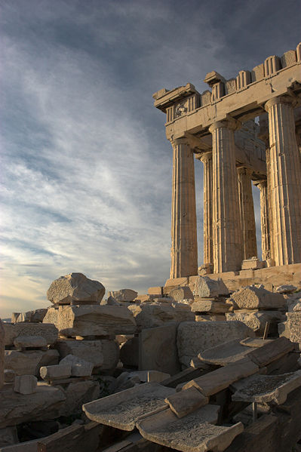
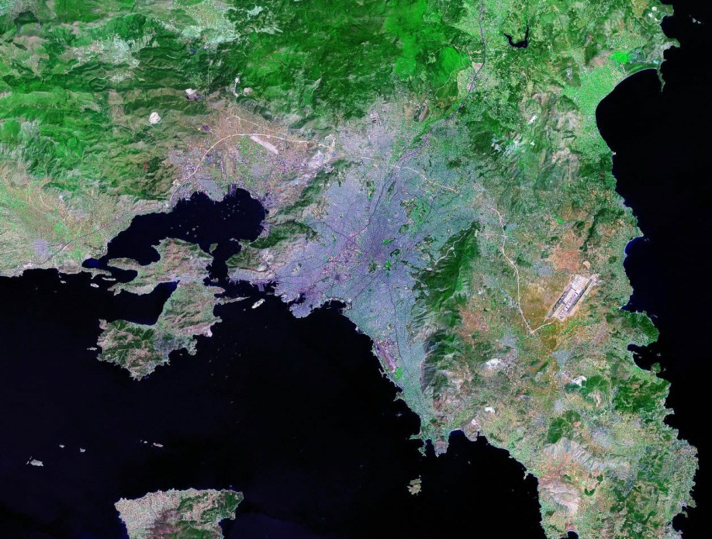
The Golden Age of Athens

Slide 2
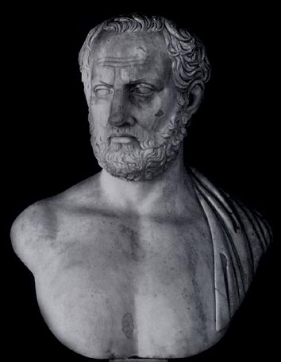
Setting the Stage
After the Persian Wars, formation of Delian League:
Alliance between 140 city-states
Athens quickly emerged as Greek leader

Slide 3
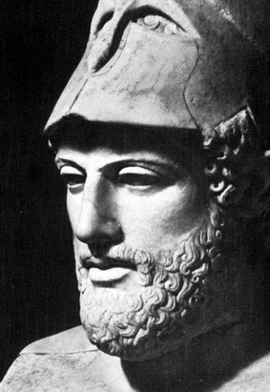
Setting the Stage
Defeat of Persians + Athenian leadership = Athenian prestige
Resulted in the GOLDEN AGE of ATHENS

Slide 4
Setting the Stage
477 to 431 BC:
Intellectual & artistic learning greatly increased
During the GOLDEN AGE:
Drama, sculpture, poetry, science architecture, philosophy, etc.

Slide 5
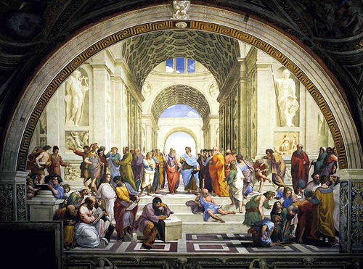
Golden Politics

Slide 6
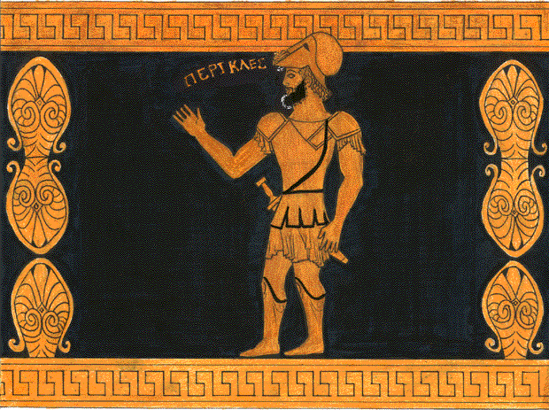
Golden Politics
Pericles, great Athenian leader
3 GOALS for ATHENS:
Strengthen democracy, strengthen the empire & glorify Athens

Slide 7
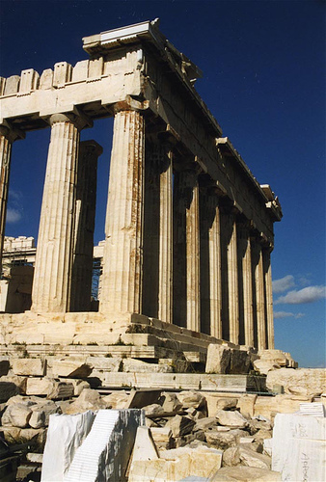
Golden Politics
Democracy:
Increased the number of public officials who received salaries
Introduced direct democracy; allowed for increased participation

Slide 8
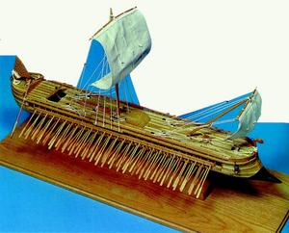
Golden Politics
Empire:
Pericles built strongest navy of its time
Greatly increased trade

Slide 9
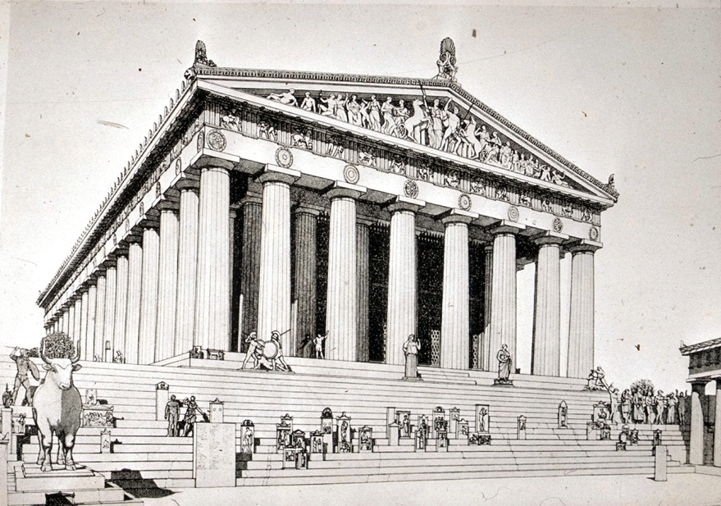
Golden Politics
Glorifying Athens:
Pericles began the beautification of Athens
Paid artists, architects and other workers to manage this task

Slide 10
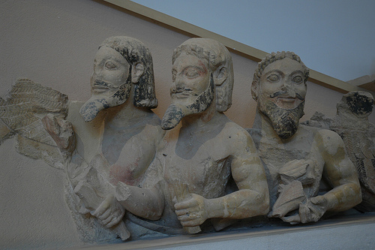
The Golden Arts

Slide 11
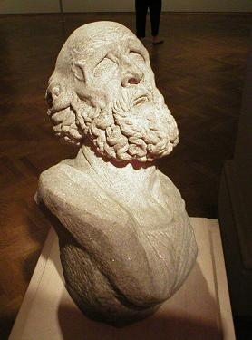
Golden Art
Art and Sculpture:
Grace, strength, perfection
Portrayal IDEAL beauty
Focused on harmony, order, balance and proportion
Notes:
Art and Sculpture:
Grace, strength, perfection
Portrayal IDEAL beauty
Focused on harmony, order, balance and proportion

Slide 12
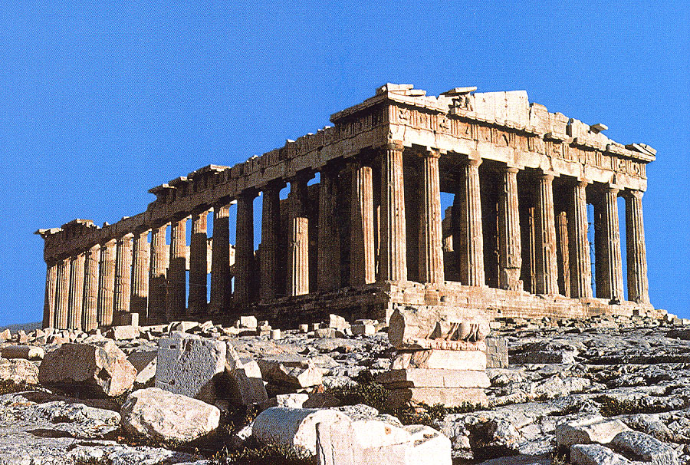

Slide 13
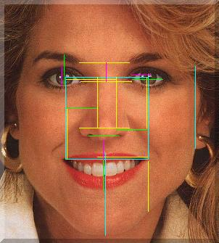
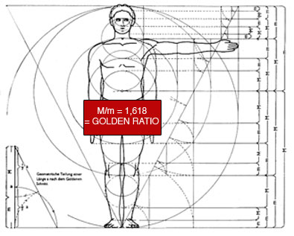
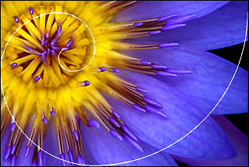
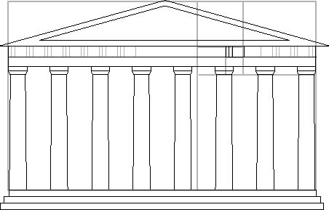
The Golden Mean
0, 1, 1, 2, 3, 5, 8, 13

Slide 14
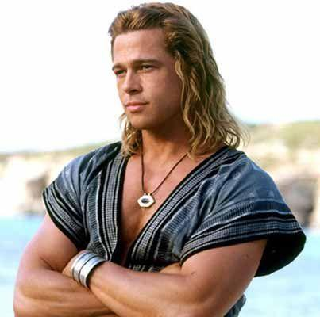
https://www.easycalculation.com/health/golden-ratio-beauty-calculator.php
Male Celebs Female Celebs
Brad Pitt Kate Upton
Ryan Gosling Miley Cyrus
George Clooney Beyonce

Slide 15
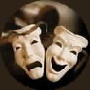
Golden Drama
Tragedy:
SERIOUS DRAMA; love, hate, war & betrayal
The main character is generally a tragic hero with a fatal flaw, usually excessive pride
Notes:
Dramatists who wrote TRAGEDIES:
Aeschylus: Oresteia
Sophocles: Antigone
Euripides: Medea

Slide 16
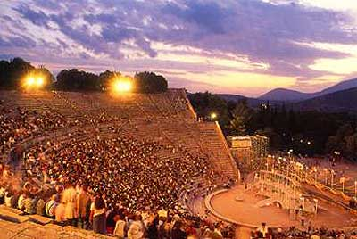
Golden Drama
Comedy:
Slapstick comedy & crude humor
Poked fun at politics, ideas and respected leaders

Slide 17
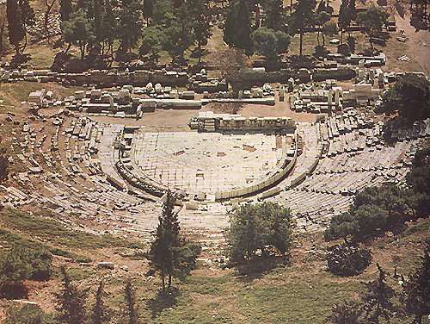
Notes:
Dionysus Theater

Slide 18
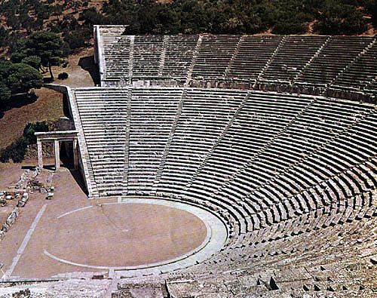

Slide 19
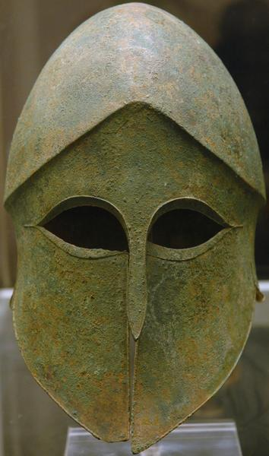
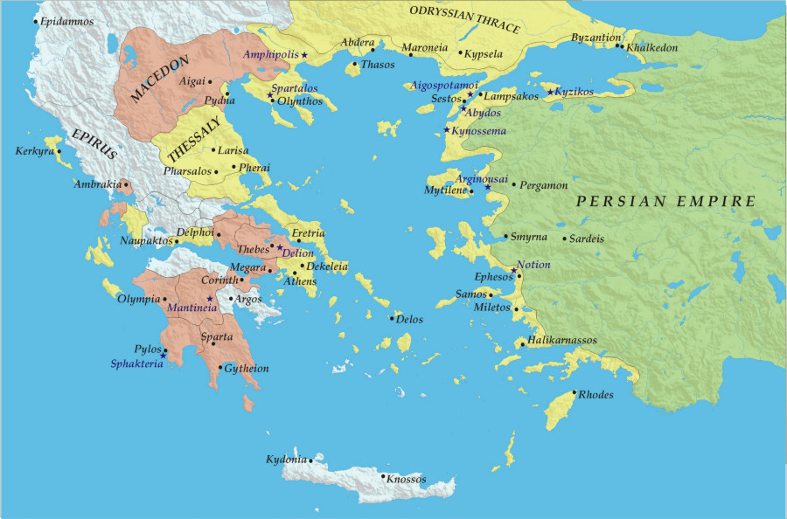
Resentment

Slide 20
Resentment
As Athens flourished, resentment began to develop on the Peloponnesus Peninsula
Sparta resisted Athens & formed their own alliance (The PELOPONNESIAN LEAGUE)

Slide 22
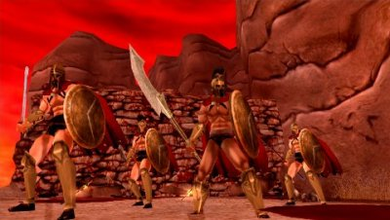
Resentment
As Athenian wealth & power INCREASED, so did hostility among other city-states
Led to the Peloponnesian War:

Slide 23
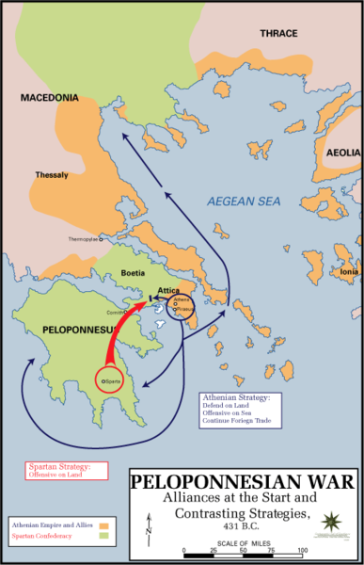
Peloponnesian War

Slide 24
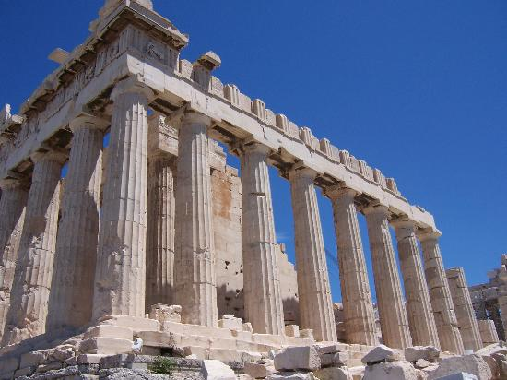
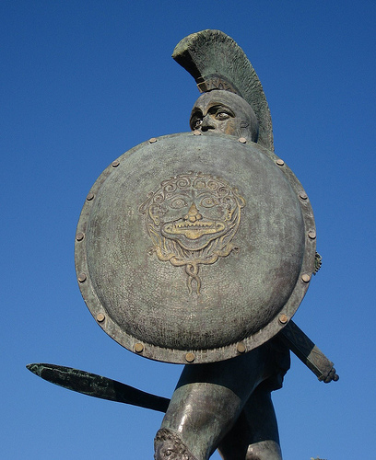
Dates & Opposition
Dates:
431 – 404 BC
Opponents:
Athens v. Sparta

Slide 25
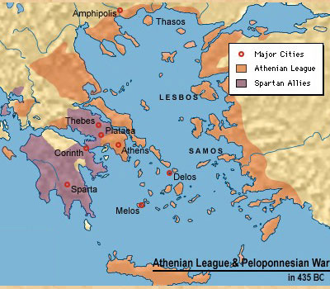
Major Events & Facts
Civil war
Different strengths; evenly matched
WHY?
Athens – SEA POWER
Sparta – LAND POWER

Slide 26
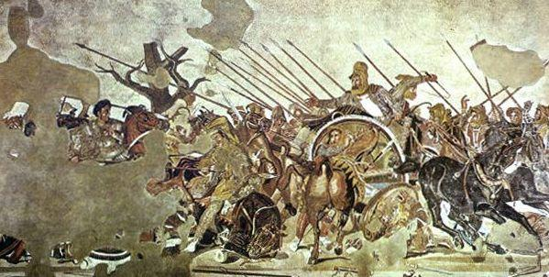
Major Events & Facts
Eventually the Spartans were able to trap the Athenians against the sea
404 BC:
Sparta captured Athens & ended Athenian domination of Greek world
Refused to burn it to the ground
WHY?

Slide 27
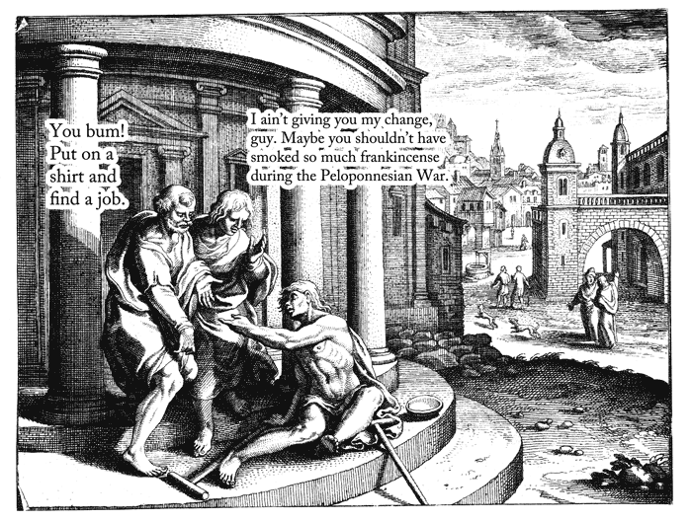
The Aftermath

Slide 28
The Aftermath
What happened to Athens after the Peloponnesian War?
DECLINE of the Golden Age
NO MORE empire, power or wealth

Slide 29
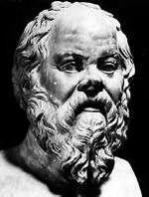
The Aftermath
After the Peloponnesian War many Greeks lost confidence in Athens
Led to the rise of philosophy & those who wanted seek the truth

Slide 30
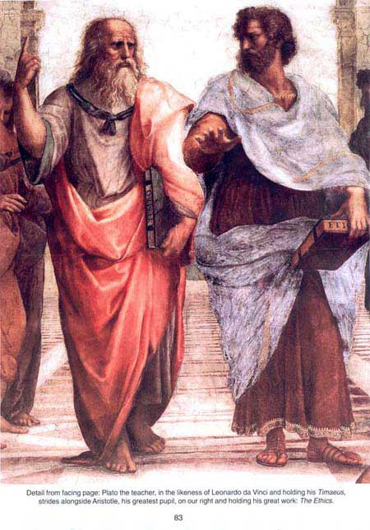
The Aftermath
3 BIG THREE:
Socrates
Plato
Aristotle

